Slide 1
The k-means clustering algorithm
Tine

Slide 2
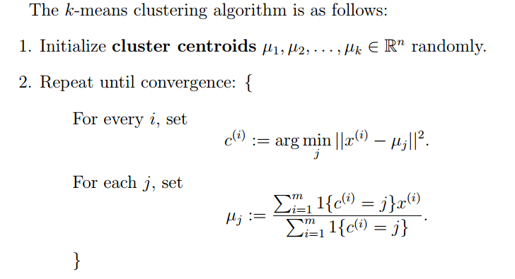
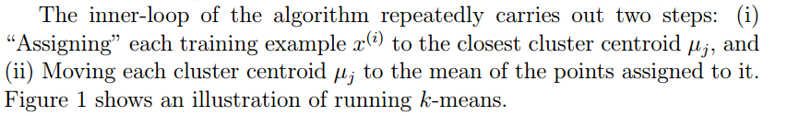

Slide 3
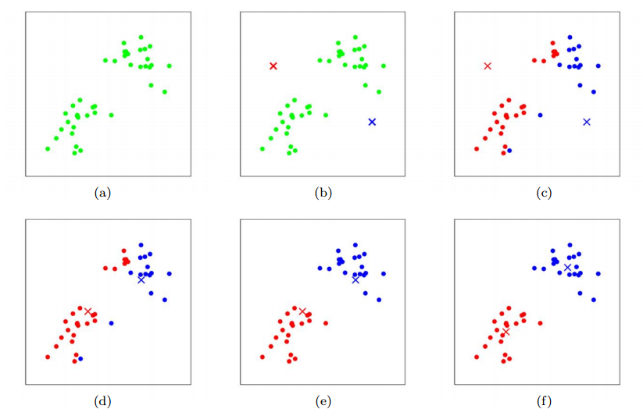

Slide 4
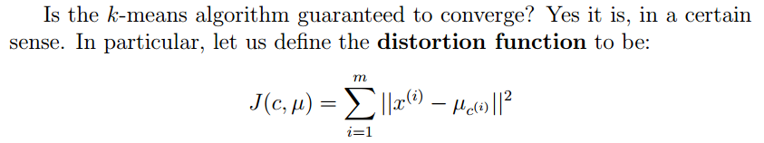

Slide 5
The distortion function J is a non-convex function, and so coordinate descent on J is not guaranteed to converge to the global minimum. In other words, k-means can be susceptible to local optima.
Very often k-means willwork fine and come up with very good clusterings despite this.
One common thing to do is run k-means many times (using different random initial values for the cluster centroids). Then, out of all the different clusterings found, pick the one that gives the lowest distortion J(c, µ)

